Slide 2
Icebreakers

Slide 3
Challenge 1

Slide 4
In complete silence organise yourselves into age order. Without talking to each other, find a different way to communicate.

Slide 5
Challenge 2

Slide 6
In complete silence organise yourselves into alphabetical order. Without talking, find a different way to communicate.

Slide 7
Challenge 3

Slide 8
With a stop watch on the board, sit in silence for 5 minutes. No talking, no noises, total silence.

Slide 9
Discuss
1. How did it feel to be silent for 5 minutes?
2. Was it easy?
3. What did you hear?
4. Is there ever total silence?
5. Did you learn anything about yourself or in general by being silent for this long?

Slide 10
Lent

Slide 11
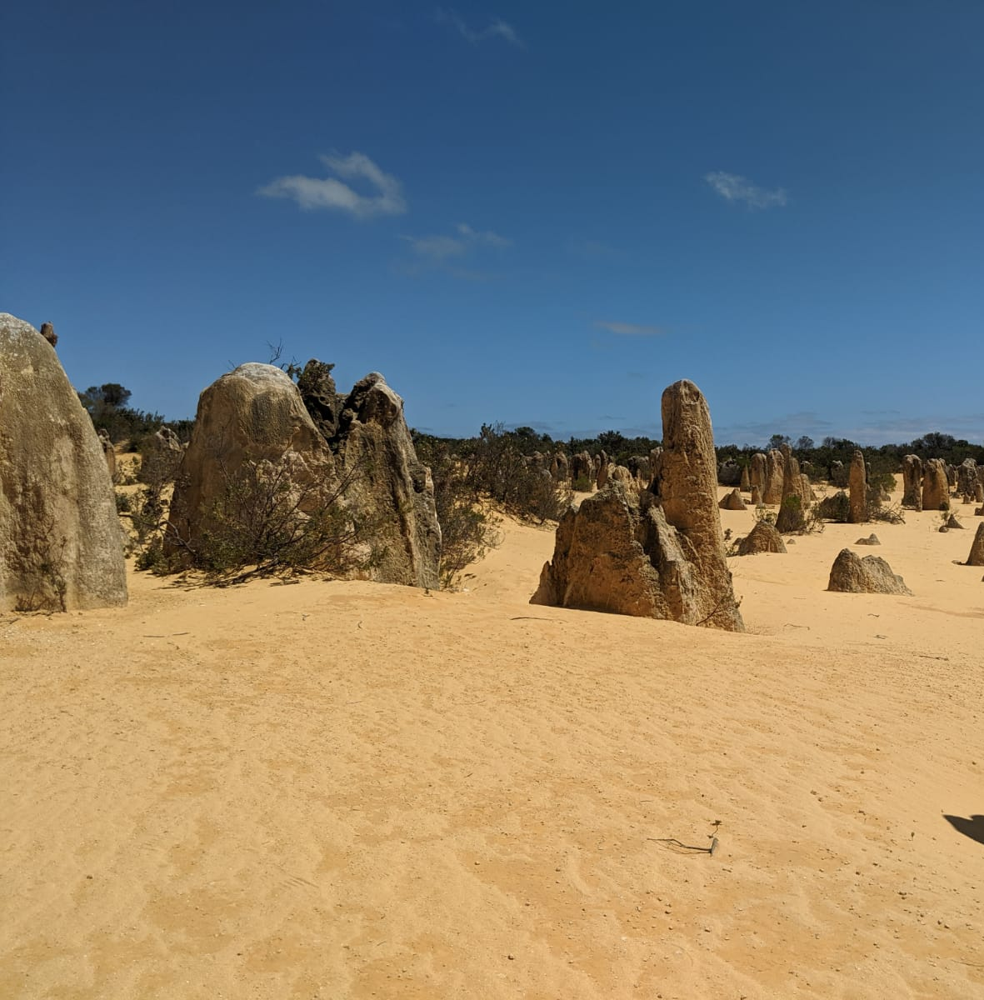
A time of preparation for Easter It lasts 40 days and 40 nights (not including Sundays) from Ash Wednesday until Holy Saturday (the day before Easter Sunday)
It’s 40 days and 40 nights because that’s how long Jesus spent in the desert

Slide 12
All Christian denominations spend this time preparing for the high point of the liturgical year and Christian story, the Resurrection
To mark Lent, Christians do three main things:
£
Give things up (fast)
Make a special effort to help others (almsgiving)
Spend more time in prayer

Slide 13
We think Jesus spent most, if not all, of his time in the desert in
silence

Slide 14
How much time do you spend in silence each day?
How much time just contemplating?
How much is taken up on Facebook, Instagram, TikTok, Twitter etc?
silence

Slide 15
Did you know that the average 16 to 24 year old spends 3 hours a day online!
How else could you spend that time?
…spending quality time with friends and family
…getting outside in nature
…praying and meditating
..exercising
silence

Slide 16
Think…If my day were a musical score, how full of notes would it be?
Link to John Cage Video
silence

Slide 17
siLENT: What is it all about?
A ‘Million Minutes of Silence’ is a simple idea - each minute is sponsored to raise money for social action projects supporting young people. Throughout Lent schools, parishes, and individuals will help clock up a million minutes!
We want this year to be the biggest year yet, to show our collective support for young people, and to raise at least a million pennies (which is £10,000!) to help young people restore our world.

Slide 18
It’s a time to give up the things that fill our everyday life with noise and is an opportunity to stand in solidarity with young people who don’t have a voice, for whom silence isn’t a choice.
Since our formation in 2011 we have created over 1,100,000 thousand minutes of silence and we are on the way to 100s of thousands more minutes in 2021.
Lent is a great time to try something different…
Silence!

Slide 19
Dignity and Equality Service to the Poor Care for the Earth
Peace and Solidarity Building community
Dignity of Students and Workers
Sponsorship money raised through siLENT goes directly to our youth social action projects which are inspired by Catholic social teaching principles…

Slide 20
All the projects that we support enable young people to change their life and their world.

Slide 22
Why not decide to stay siLENT for a change?
Stay siLENT in solidarity with young people who don’t have a voice.
Help Million Minutes raise money for young people to make a change.
SIGN UP: https://millionminutes.org/silent

Slide 23
siLENT Activity
Get yourselves into groups of 4/5.
Each group will be given a card which will have one Station of the Cross on it, and a small explanation about what is happening at this station.
As a group you need to put together a siLENT performance of this Station of the Cross. This could be a mime (silent drama) or a freeze frame.
You have 10 minutes to put it together before we perform them for the class.

Slide 24
We are going to bring this lesson to a close with another time of silence, only for a few moments this time but you will be guided through it as a way of praying.

Slide 26
Follow us:
@Million_Minutes
@millionminutes11
Million Minutes
millionminutes
Email: info@millionminutes.org
Registered Charity Number: 1140079
Million Minutes, 55 Westminster Bridge Road, South Bank, London, SE1 7JB

