Slide 1
CONTENTS
Short reflection (10 mins max)
Longer reflection (20 – 25 mins max)
Includes:
Reflection – Scripture/Quote
Reflective exercises
Discussion questions
Prayer

Slide 2
SHORT REFLECTION

Slide 3
Where is the Holy Spirit drawing you? Your community?

Slide 4
In the name of the Father, the Son, and the Holy Spirit

Slide 5
Jesus came down to Earth to be among the people and teach them how to live, to share God’s love and make of us disciples. After the resurrection, when it was time to depart from this Earth, Jesus told His disciples that it was His time to leave, but that the Holy Spirit would be sent to them, to stay with and guide them.
Notes:
Spend five minutes watching the following video clip about The Holy Spirit: https://www.youtube.com/watch?v=oNNZO9i1Gjc

Slide 6
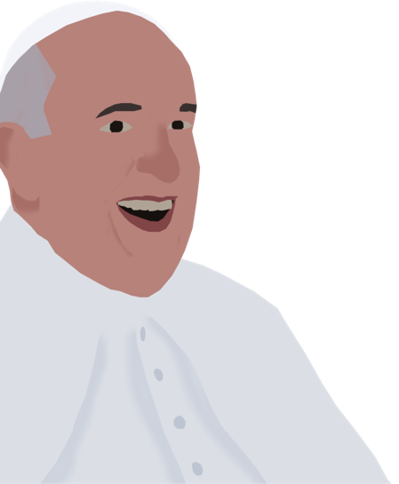
Pope Francis
“How can I serve people better and prove most helpful to our world and to the Church? What is my real place in this world? What can I offer to society? Even more realistic questions then follow: Do I have the abilities needed to offer this kind of service? Could I develop those abilities?”
Letter to young people, “Christ is Alive”

Slide 7
REFLECT
Think about your school community, parish community, or your local area
How has it changed since the coronavirus pandemic? What has changed for the better? For the worse?
What kind of community do we dream of?
What can we do to bring greater community cohesion, participation and resilience going forward?
Notes:
If you are taking part in this activity online or in person, spend some time sharing your thoughts with those in your group and listening to how they have found this time of lockdown.

Slide 8
PRAYER
Come Holy Spirit, fill the hearts of your faithful and kindle in them the fire of your love. Send forth your Spirit and they shall be created. And You shall renew the face of the earth. Amen.

Slide 9
LONGER REFLECTION

Slide 10
Where is the Holy Spirit drawing you? Your community?

Slide 11
In the name of the Father, the Son, and the Holy Spirit

Slide 12
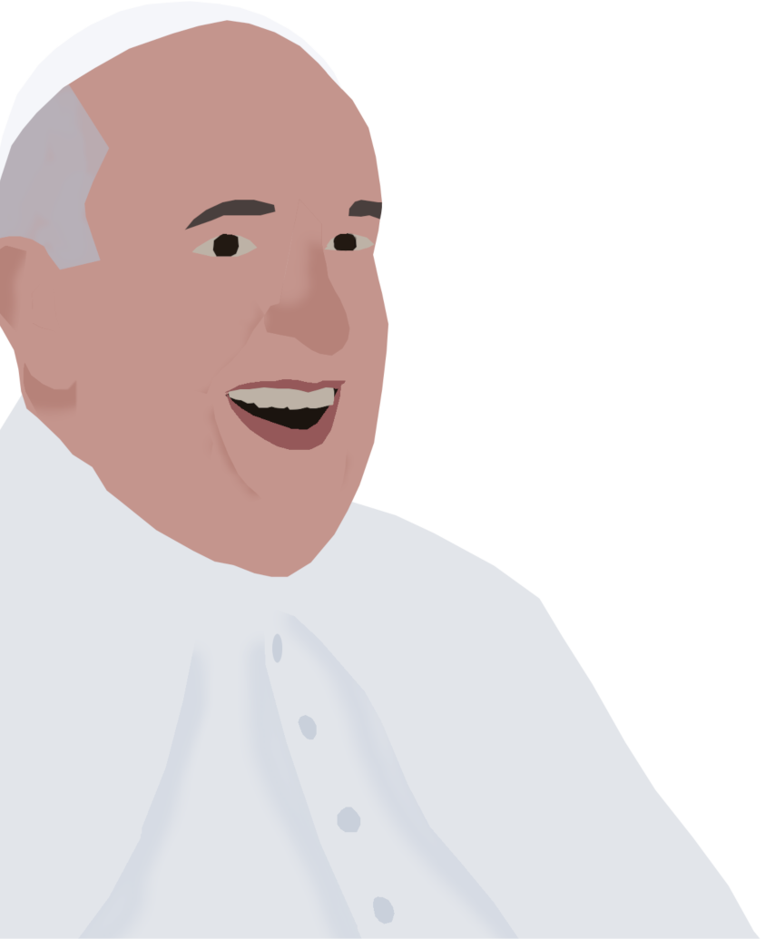
Faith Sharing
Christus Vivit #285: When seeking to discern our own vocation, there are certain questions we ought to ask. We should not start with wondering where we could make more money, or achieve greater recognition and social status. Nor even by asking what kind of work would be most pleasing to us. If we are not to go astray, we need a different starting point. We need to ask: Do I know myself, quite apart from my illusions and emotions? Do I know what brings joy or sorrow to my heart? What are my strengths and weaknesses? These questions immediately give rise to others: How can I serve people better and prove most helpful to our world and to the Church? What is my real place in this world? What can I offer to society? Even more realistic questions then follow: Do I have the abilities needed to offer this kind of service? Could I develop those abilities?
Notes:
Discussion: Choose just one or two of these questions to think over, as a group or by yourselves, and share your thoughts.
Clip:
The Holy Spirit: https://www.youtube.com/watch?v=oNNZO9i1Gjc (4:10 minutes)
Music:
Spirit of the Living God: https://www.youtube.com/watch?v=ogGOlGswStA
Breathe on me, Breath of God: https://www.youtube.com/watch?v=S140Ew5PhI8

Slide 13
ACTIVITY
How has your community changed since Covid-19?
…In your school community
…….Parish community
…in your local area
Notes:
Questions to discuss:
How has it changed since the coronavirus pandemic?
How has it changed for the better?
What have you witnessed, either yourself, or in the news or on social media, where communities are being pulled apart? What do you think the causes, and consequences, of this are?

Slide 14
ACTIVITY
Where is God and the Holy spirit drawing you….
…In your school community
…….Parish community
…in your local area
Notes:
Questions to discuss:
What kind of community do we dream of?
What can we do to bring greater community cohesion, participation and resilience going forward?
Explore some examples of young people doing great things in their community: https://millionminutes.org/stories-of-change
Do you have your own examples to share with one another?
Guidance and concrete ways of Building Community: https://millionminutes.org/buildingcommunity

Slide 15
Listening to the Spirit…
Before we spring into action, it is helpful to take time to discern, or listen, to the Holy Spirit and where it is drawing us. First we must take a look at ourselves: do we live with love and care for one another, for the stranger, the poor? Do we welcome others as Jesus did? Even those on the margins, those rejected by society, the ‘foreigner’? Do we make choices for the benefit of ourselves, or for our community and the common good? Are we putting our talents to good use?

Slide 16
Listening to the Spirit…
How might we become beacons of hope in our own community? Being examples of God’s love?

Slide 17
PRAYER
Come Holy Spirit, fill the hearts of your faithful and kindle in them the fire of your love. Send forth your Spirit and they shall be created. And You shall renew the face of the earth. Amen.

Slide 18
Where is the Holy Spirit drawing you? Your community?

