Slide 1
MILLION MINUTES OF CHANGE
Exploring world changing principles

Slide 2
FRAMEWORK FOR
ACTION
SEE
JUDGE
ACT

Slide 3
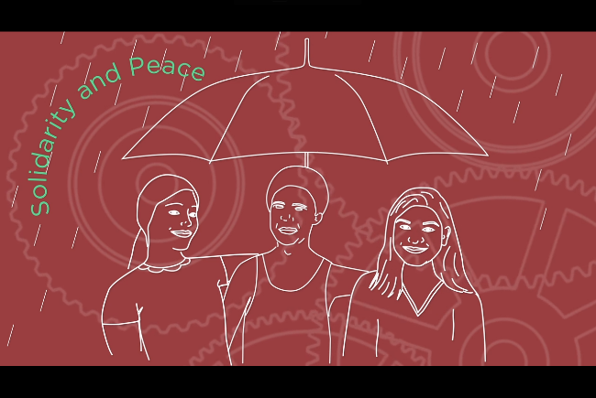
What is Catholic Social Teaching?

Slide 5
CATHOLIC SOCIAL
TEACHING
Letter
~~~~~~
~~~~~~
~~~~~~
Love from
Cardinal Nichols
Letter
~~~~~~
~~~~~~
~~~~~~
Letter
~~~~~~
~~~~~~
~~~~~~
Love from
Pope Francis
- A reflection on the message of Jesus -Informed by Scripture and Church tradition -Principles for guidance -Criteria for judgement -Directives for action

Slide 6
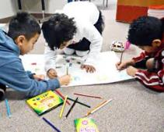
Mapping/Poster activities
OPTION ONE:
News flash posters
OPTION TWO:
Mapping activity

Slide 7
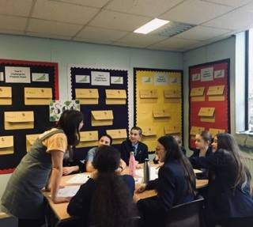
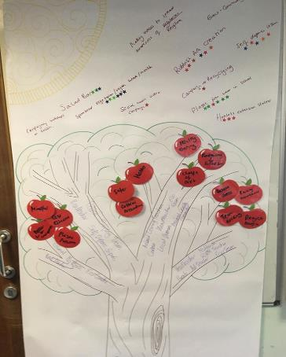
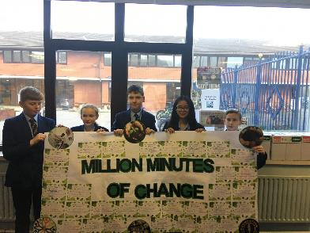
Taking Action

Slide 9
NOW…COMMIT TO ACTION…

Slide 10
Apply for a grant - create your youth led social action project

Slide 11
Help us create a 1,000,000 minutes of social action.
Go to millionminutes.org/change and tell us about your project.
We will add all your pledged time to our ‘Million Minutes of Change’ total.

Slide 12
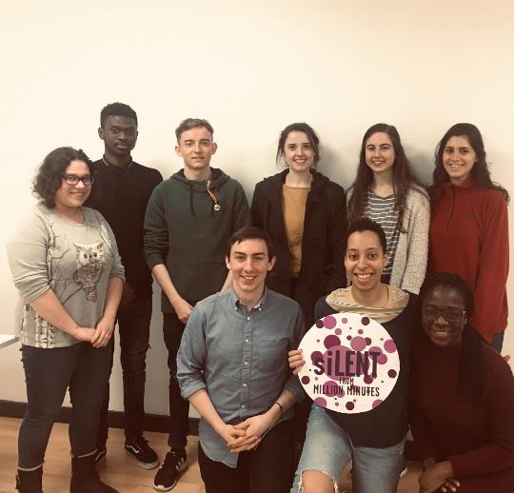
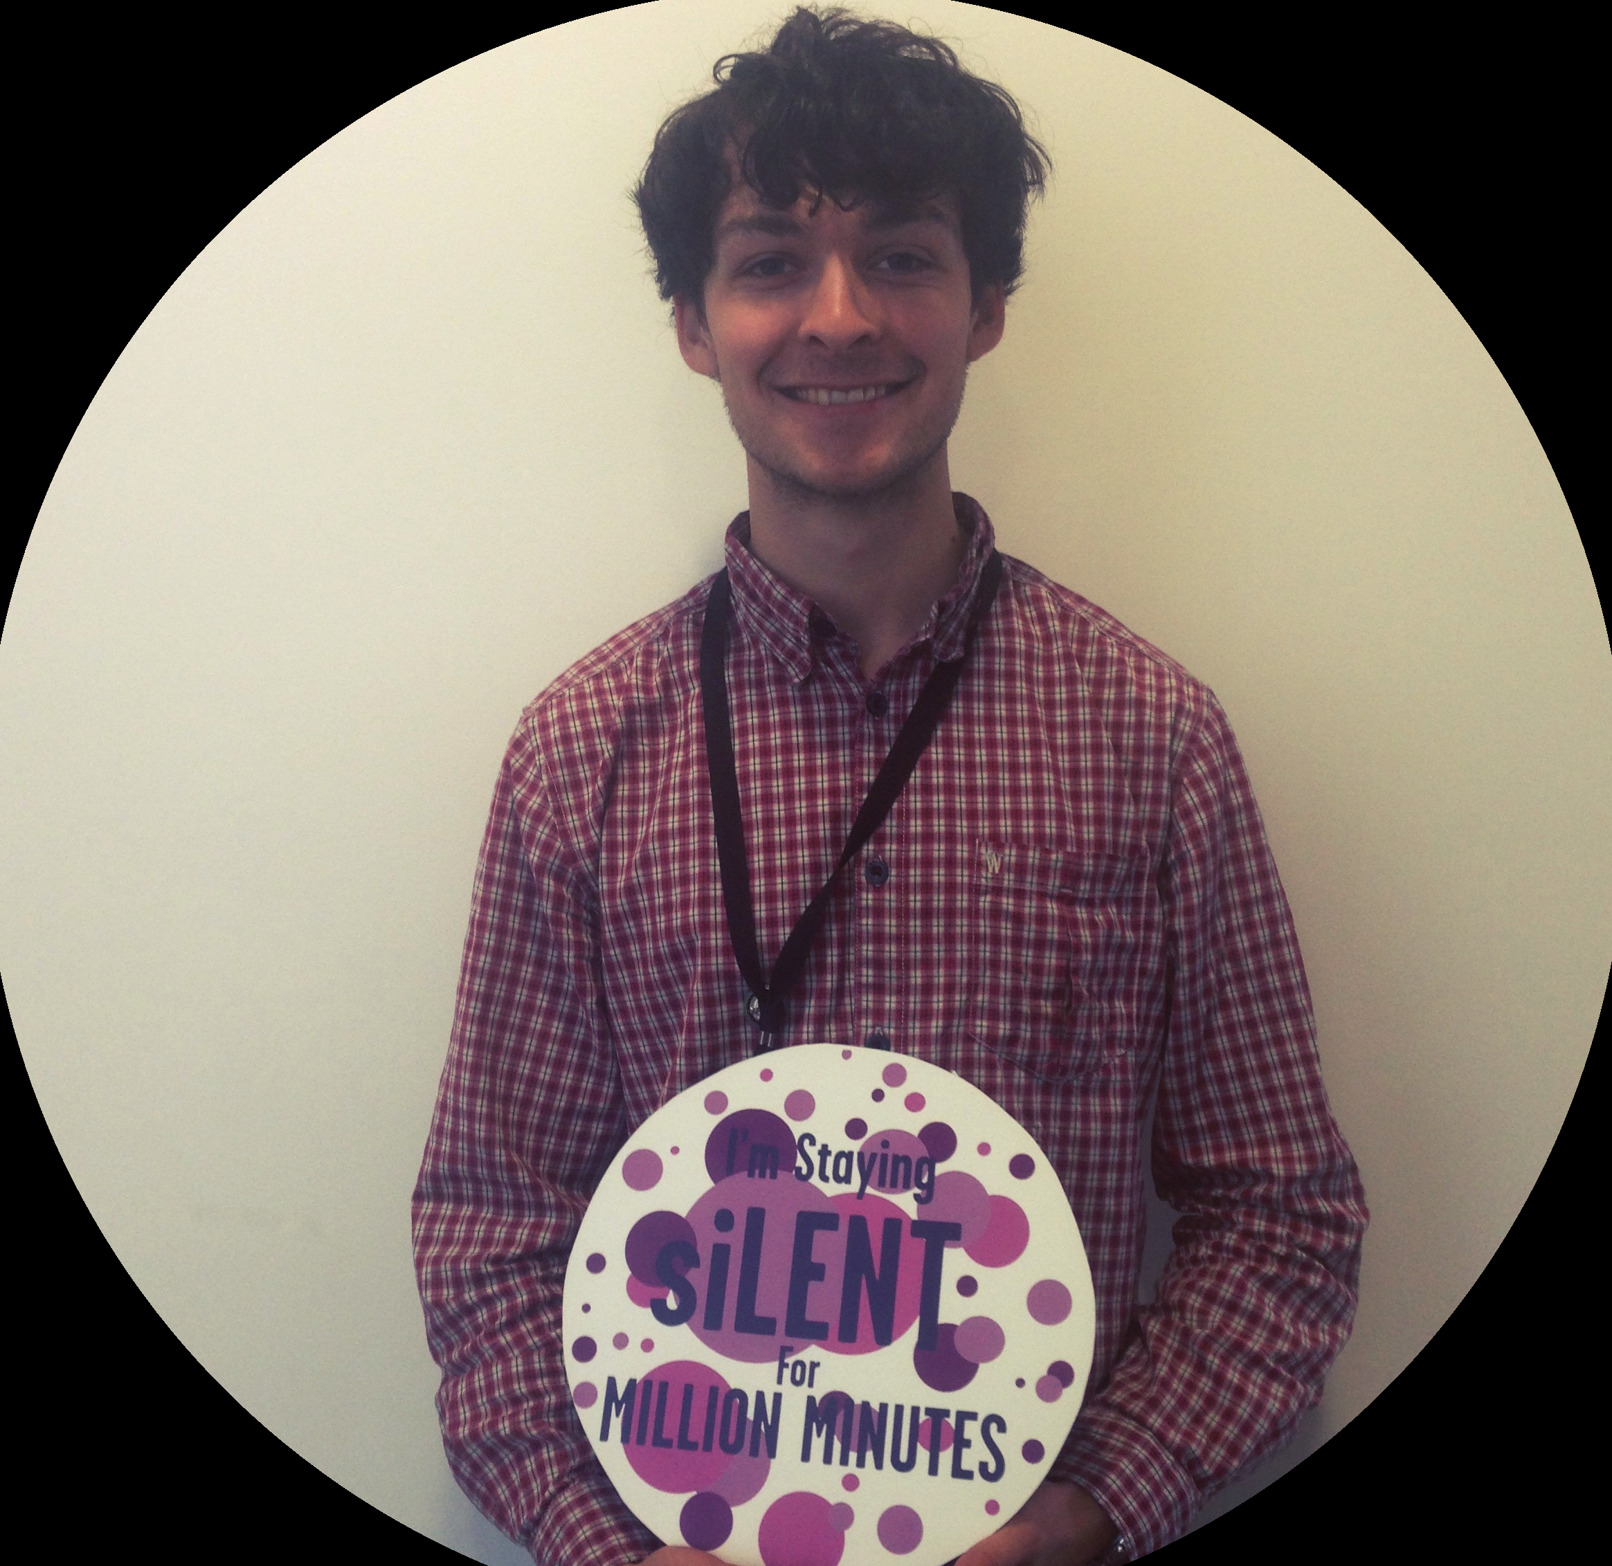
Stand up in solidarity with other young people who don’t have a voice.
Join us in Lent 2020: 26th February- 9th April

Slide 13
Nominate a young person or peer for a Celebrating Young People Award.

Slide 14
Exploring Social Justice…
“Thus has the LORD of hosts said, ‘Dispense true justice and practice kindness and compassion each to his brother; and do not oppress the widow or the orphan, the stranger or the poor; and do not devise evil in your hearts against one another.’
Zec 7:7-10

Slide 15
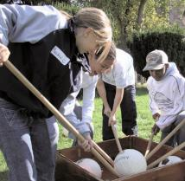
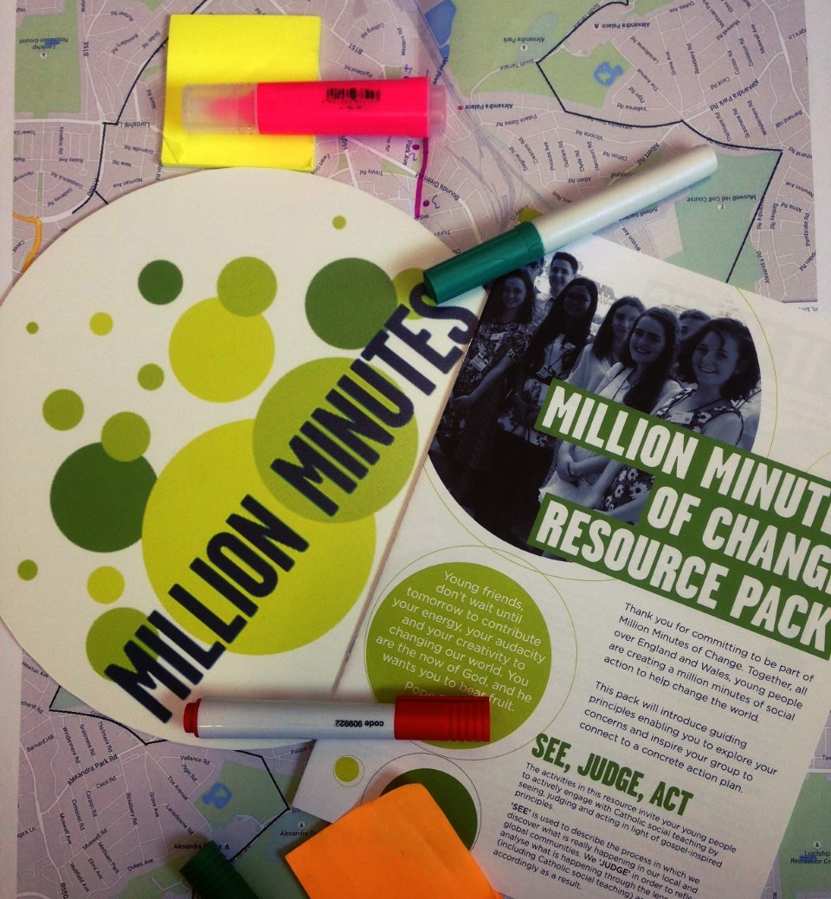
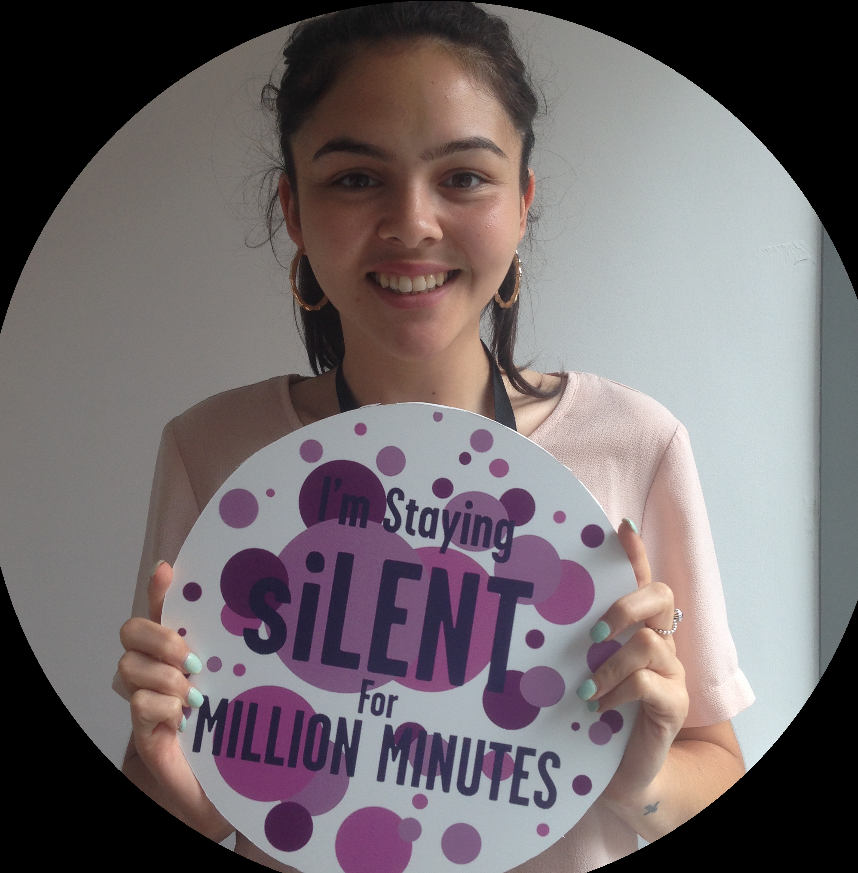
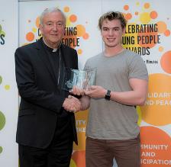
Applying for a GRANT
Please think about…
Pledging your minutes towards a social action project
Nominating young people for an AWARD
Joining SILENT

Slide 16
FIND US AT:
millionminutes.org
/change
/grants
/awards
/silent
Twitter: Million_Minutes
Facebook: millionminutes
Instagram: @millionminutes11

